Slide 1
Securing understanding of plotting coordinates
Plotting coordinates

Slide 2
how to use Oak lessons

Slide 3
I can plot coordinates in any quadrant.

Slide 4
A quadrant is any one of the four areas into which a space is divided by the x and y axes in the Cartesian coordinate system.

Slide 5

Securing understanding of plotting coordinates
Plotting coordinates in all four quadrants
Drawing axes
Plotting shapes in all four quadrants

Slide 6
Plotting coordinates in all four quadrants
What is a quadrant?
What other ‘quad’ words do we know?
Quadrilateral
Four sides
Quad-bike
Four wheels
Quadruped
Four feet
What does the ‘quad’ tell us?

Slide 7
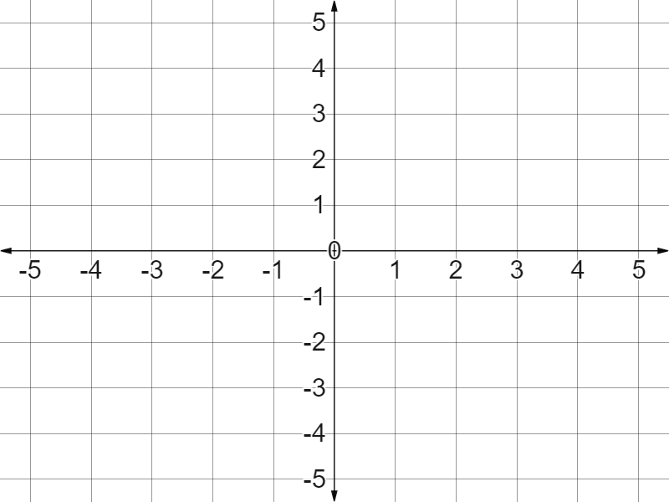
Plotting coordinates in all four quadrants
The Cartesian Coordinate Grid system.
The second quadrant
The first quadrant
We think of it in terms of its four quadrants.
So what is the difference between the quadrants?
The third quadrant
The fourth quadrant
Let’s consider the x axis for a moment.

Slide 8
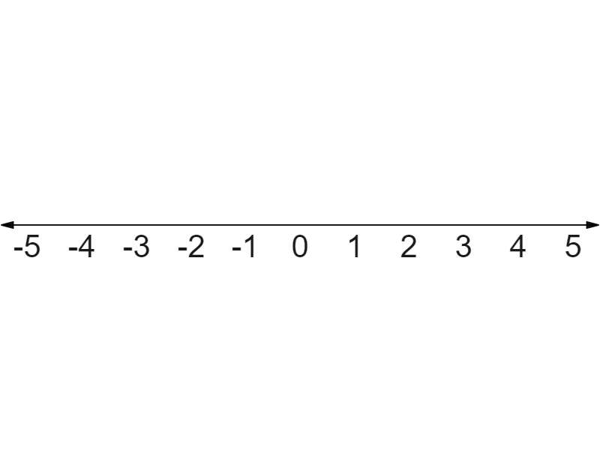
Plotting coordinates in all four quadrants
What is the difference between these two points?
✖
✖
One is plotted in the negative x direction.
One is plotted in the positive x direction.

Slide 9
Plotting coordinates in all four quadrants
Where would we put these labels on our four quadrants?
Positive x direction,
Positive y direction
Positive x direction,
Negative y direction
Negative x direction,
Positive y direction
Negative x direction,
Negative y direction

Slide 10
Plotting coordinates in all four quadrants
Where would we put these labels on our four quadrants?
Negative x direction,
Positive y direction
Positive x direction,
Positive y direction
Negative x direction,
Negative y direction
Positive x direction,
Negative y direction

Slide 11
Plotting coordinates in all four quadrants
Match the quadrant to the correct description of the coordinates.
Negative x coordinate, positive y coordinate.
1st quadrant
Negative x coordinate, negative y coordinate
2nd quadrant
Positive x coordinate, negative y coordinate
3rd quadrant
Positive x coordinate, positive y coordinate
4th quadrant

Slide 12
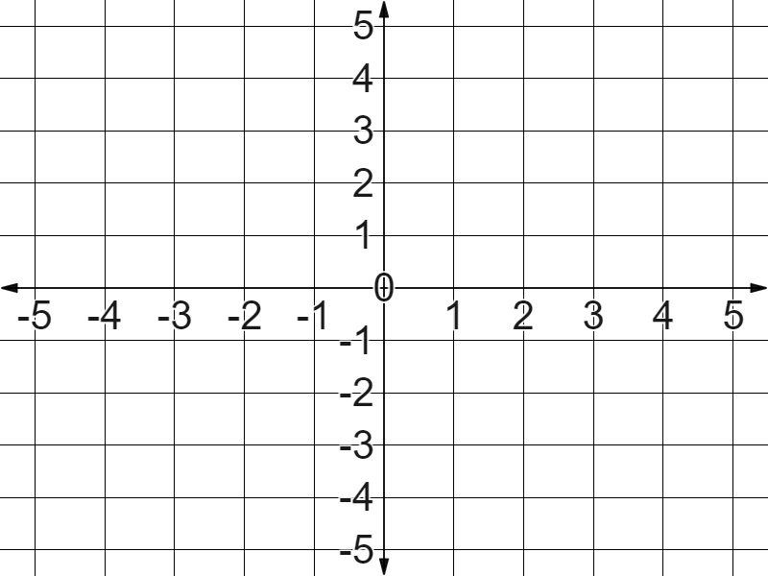
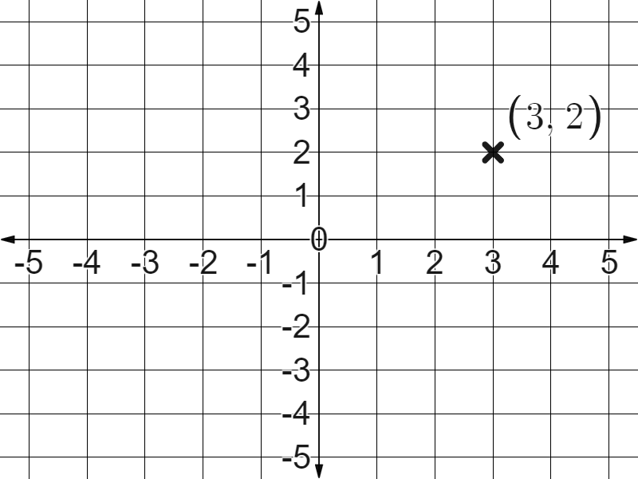
Plotting coordinates in all four quadrants
(3, 2)
The coordinate
The coordinate
(-3, 2)
What’s different when we plot (-3, 2)?
(-3, 2)
Negative x direction

Slide 13

Plotting coordinates in all four quadrants
Which of these coordinates will be in a negative x direction from the origin?
(5, -1)
(5, 1)
(-5, 1)

Slide 14
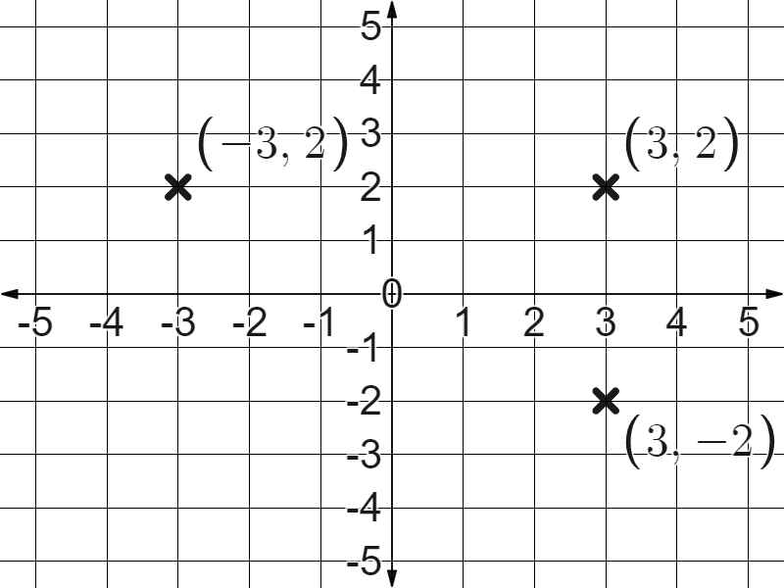
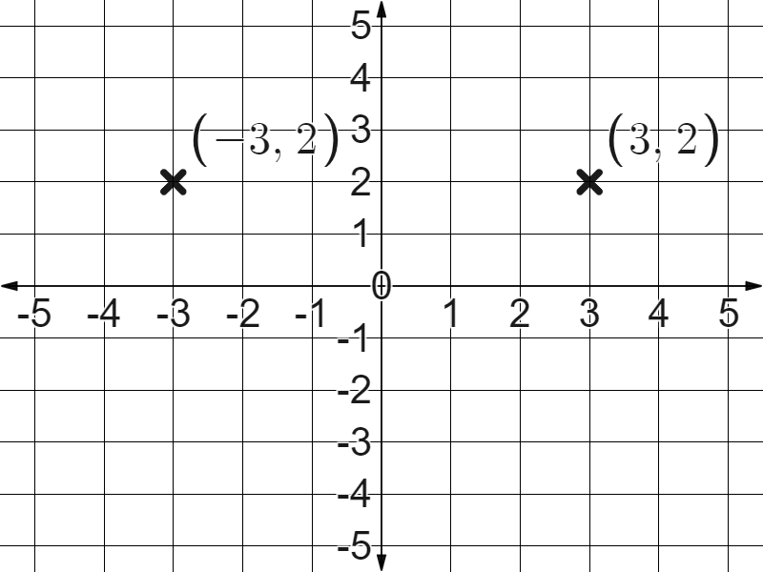
Plotting coordinates in all four quadrants
In which direction from the origin will we find these coordinates?
(3, -2)
Positive x direction
Negative y direction
(-3, -2)
(-3, -2)
(-3, -2)
Negative x direction
Negative y direction

Slide 15
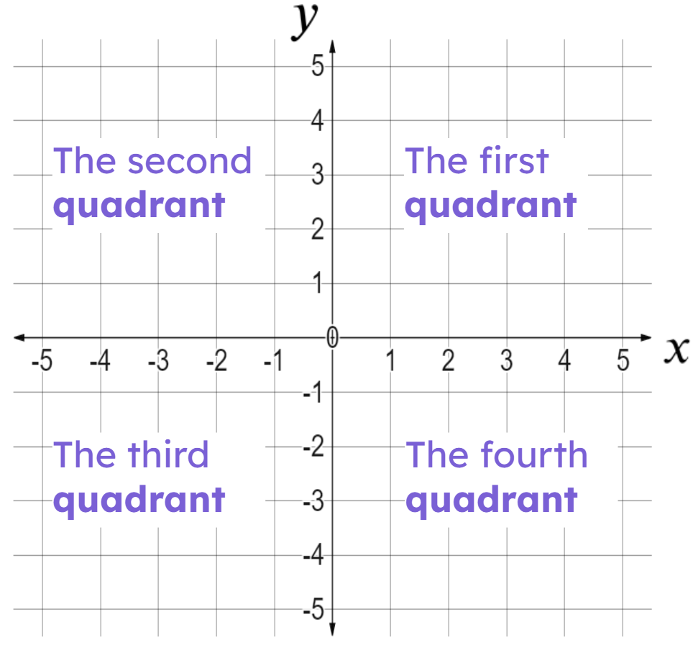
Plotting coordinates in all four quadrants
In which quadrant will you find coordinate (1, -4)?
Second quadrant
Third quadrant
Fourth quadrant

Slide 16
Plotting coordinates in all four quadrants
In which quadrant will you find coordinate (-11, -14)?
Second quadrant
Third quadrant
Fourth quadrant

Slide 17
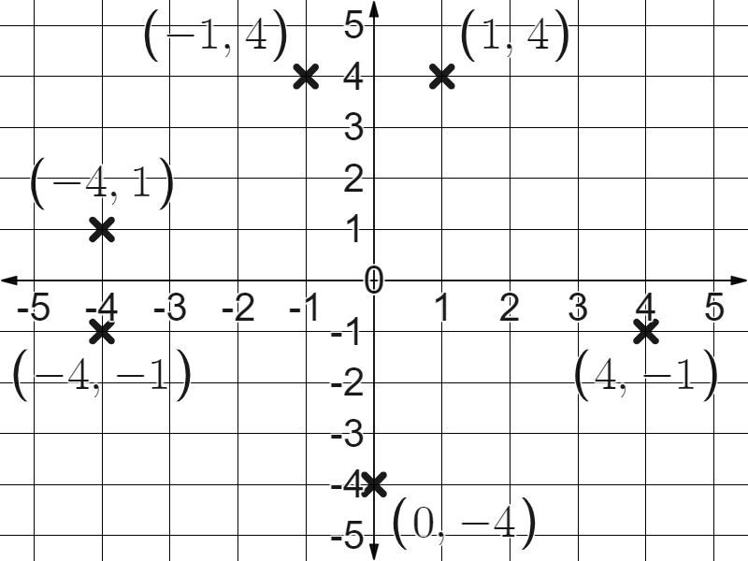
Plotting coordinates in all four quadrants
1) Plot the below coordinates:
(1, 4)
(-1, 4)
(-4, 1)
(-4, -1)
(4, -1)
(0, -4)

Slide 18
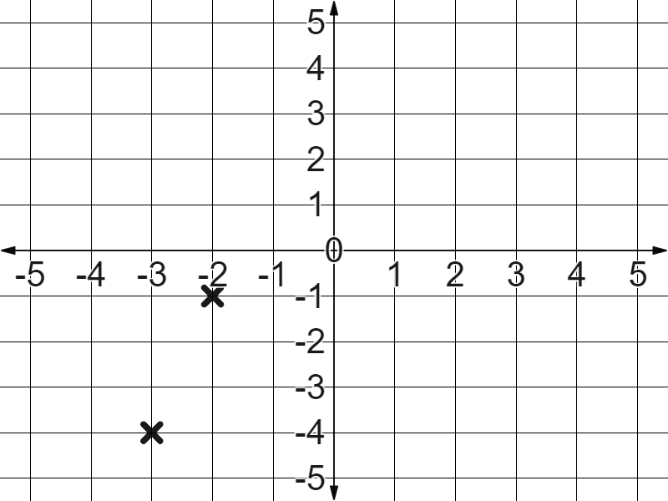

Plotting coordinates in all four quadrants
2) In Laura’s book, you see that she has plotted the coordinates (2, -1) and (-3, 4) like this.
What feedback will you give her to correct her work?

Slide 19
Plotting coordinates in all four quadrants
1) Plot the below coordinates:
(1, 4)
(-1, 4)
(-4, 1)
(-4, -1)
(4, -1)
(0, -4)

Slide 20
Plotting coordinates in all four quadrants
1) Plot the below coordinates:
(0, -4)
Zero in the x direction
Negative four in the y direction

Slide 21
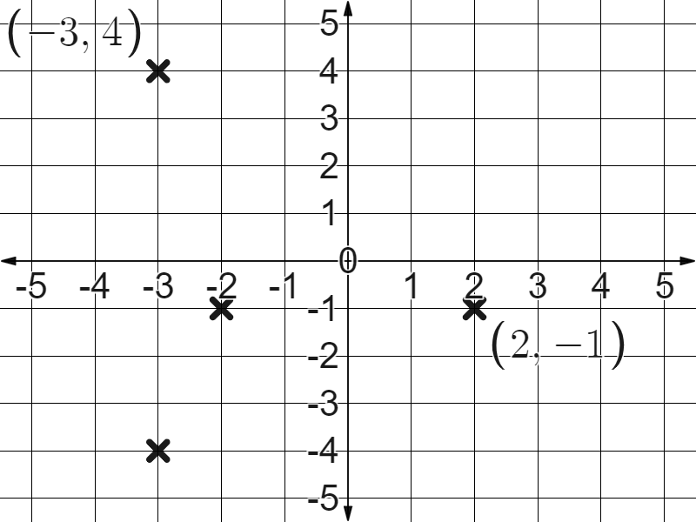
Plotting coordinates in all four quadrants
2) In Laura’s book, you see that she has plotted the coordinates (2, -1) and (-3, 4) like this.
Your feedback might have included, “follow the axes in the correct direction depending on the value of the coordinates”.

Slide 22
Securing understanding of plotting coordinates
Plotting coordinates in all four quadrants
Drawing axes
Plotting shapes in all four quadrants

Slide 23
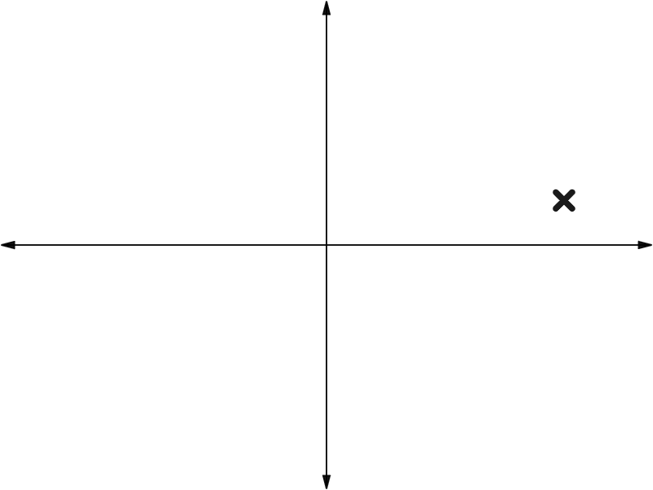
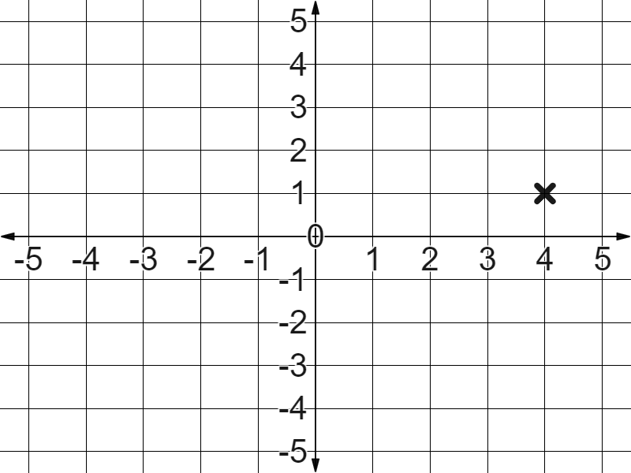
Drawing axes
What is this coordinate?
Without grid lines and accurately labelled axes it is difficult to read or plot coordinates accurately.

Slide 24
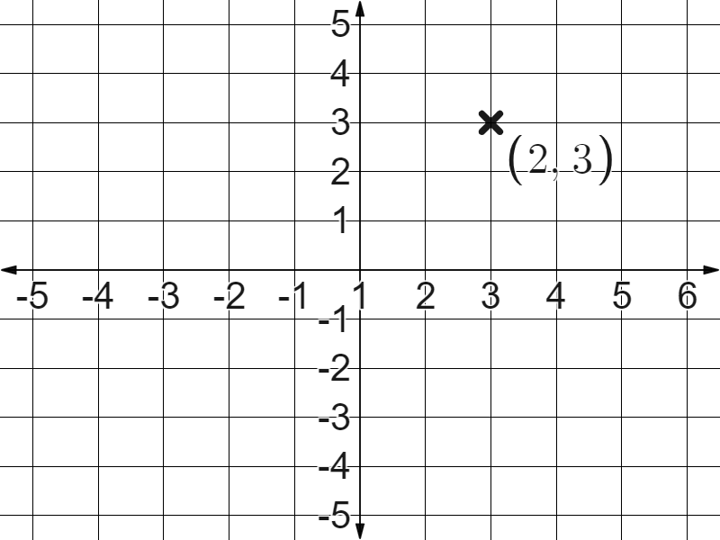
Drawing axes
What is wrong with this coordinate?
It looks like 2 in the x direction and 3 in the y direction but, it doesn’t read like it!
It looks like 2 in the x direction and 3 in the y direction but,
What is wrong?
The axes. The origin is marked as 1 on the x axis.

Slide 25
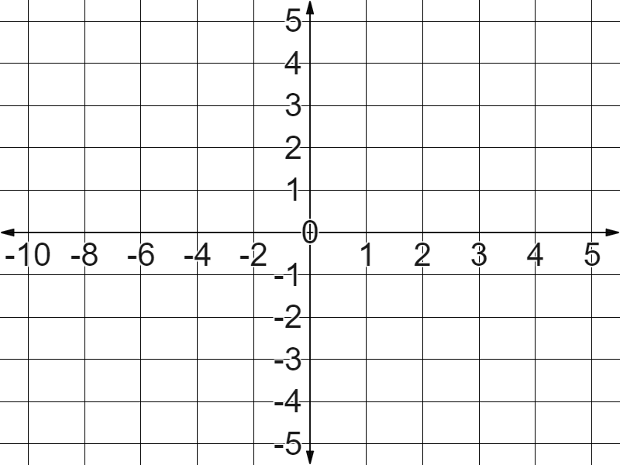
Drawing axes
What should go in these blank spaces to keep the scale on the x axis consistent?
It’s fine that the scale is different on the x and y axes, just so long as it is the same within each one.
2
4
6
8
10

Slide 26
Drawing axes
1) Fill in the blanks to label this coordinate grid, keeping the scale in ones.
Don’t forget to start with the origin and work outwards.

Slide 27
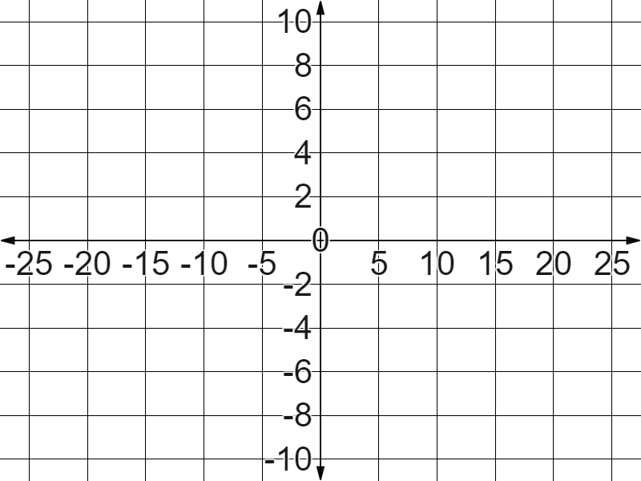
Drawing axes
2) Fill in the blanks to label this coordinate grid.
Be sure to keep the scale along each axis consistent.

Slide 28
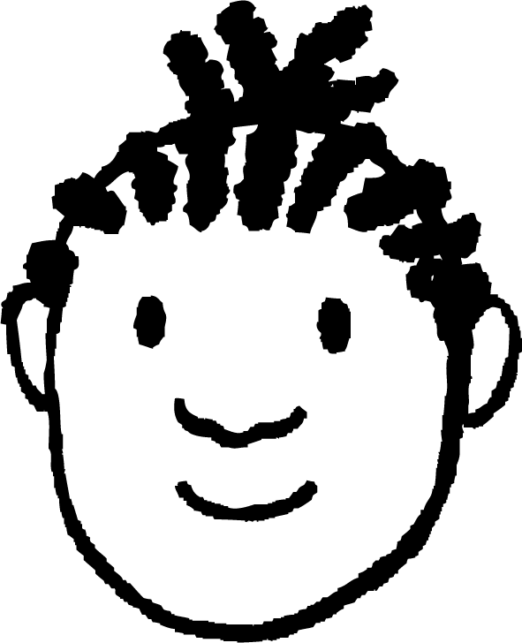
Drawing axes
3) You see this in Jacob’s book.
What advice would you give him to improve his work?
3
2
1
−3
−2
−1
1
2
3
−1
−2
−3

Slide 29
Drawing axes
1) Fill in the blanks to label this coordinate grid, keeping the scale in ones.
Don’t forget to start with the origin and work outwards.

Slide 30
Drawing axes
2) Fill in the blanks to label this coordinate grid.
Be sure to keep the scale along each axis consistent.

Slide 31
Drawing axes
3) You see this in Jacob’s book.
What advice would you give him to improve his work?
3
Your advice might have included:
2
Label your x and y axes.
1
−3
−2
−1
1
2
3
Make sure your y axis lines up with the lines in your book.
−1
−2
When labelling, start with the origin and work outwards.
−3

Slide 32
Securing understanding of plotting coordinates
Plotting coordinates in all four quadrants
Drawing axes
Plotting shapes in all four quadrants

Slide 33
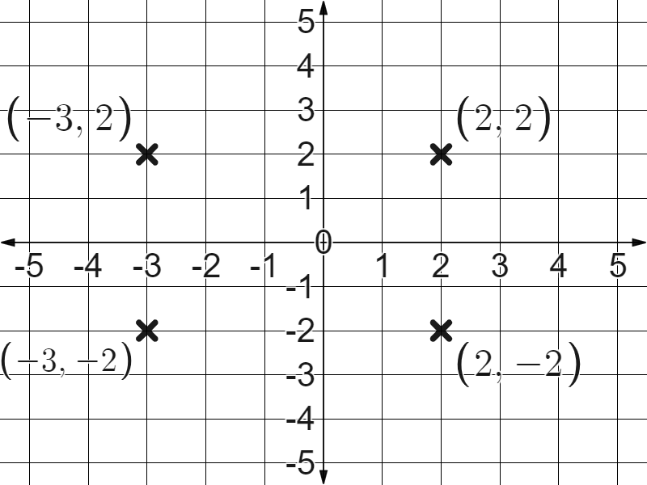
Plotting shapes in all four quadrants
When we plot these coordinates, what do you notice?
(2, 2)
(-3, 2)
(-3, -2)
(2, -2)
They form a rectangle with sides parallel to the x and y axes.

Slide 34
Plotting shapes in all four quadrants
What patterns do you see in these coordinates?
Matching x coordinates.
Matching y coordinates.

Slide 35
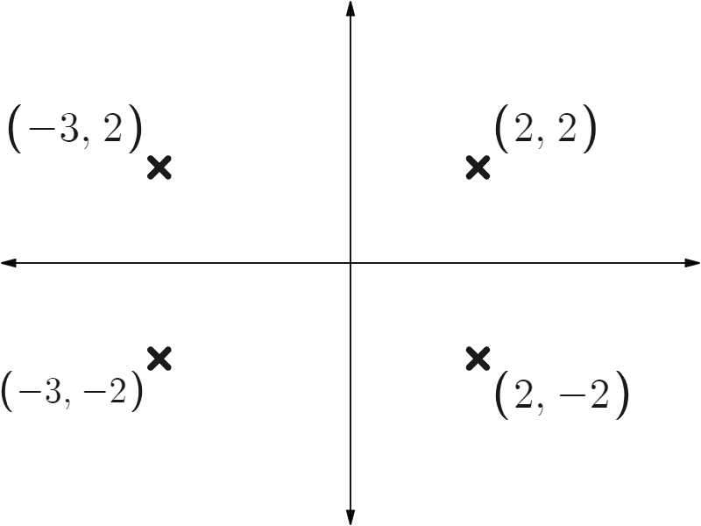
Plotting shapes in all four quadrants
That means for this type of problem we could have found a coordinate without the grid lines or labels.

Slide 36
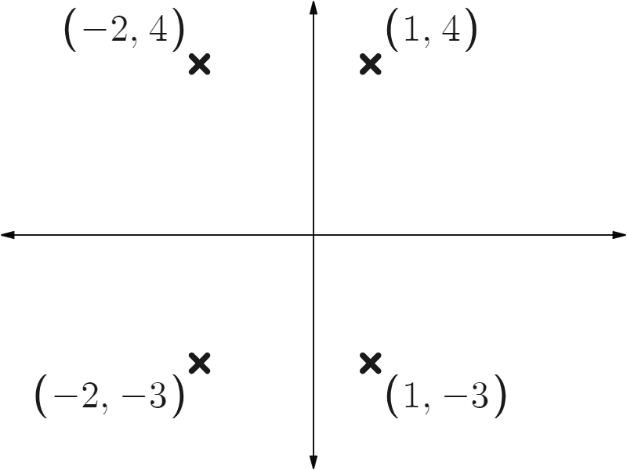
Plotting shapes in all four quadrants
Fill in the missing coordinates of this rectangle.

Slide 37
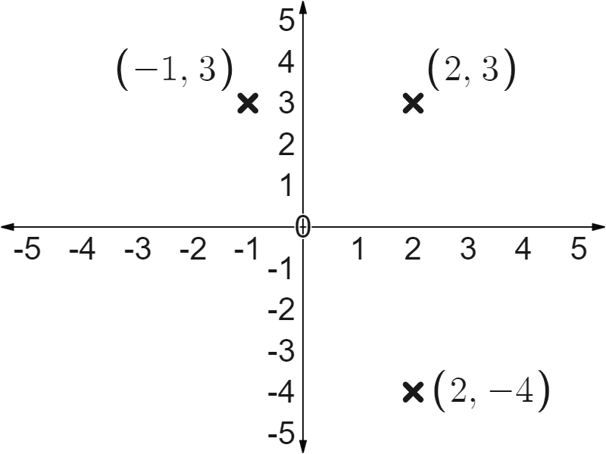
Plotting shapes in all four quadrants
What coordinate must we add here to form a rectangle?
(-1, -4)
(-1, -4)

Slide 38
Plotting shapes in all four quadrants
1) Plot these coordinates.
What shape do they form?
(3, 1)
(-2, 1)
(-2, -3)
(3, -3)

Slide 39
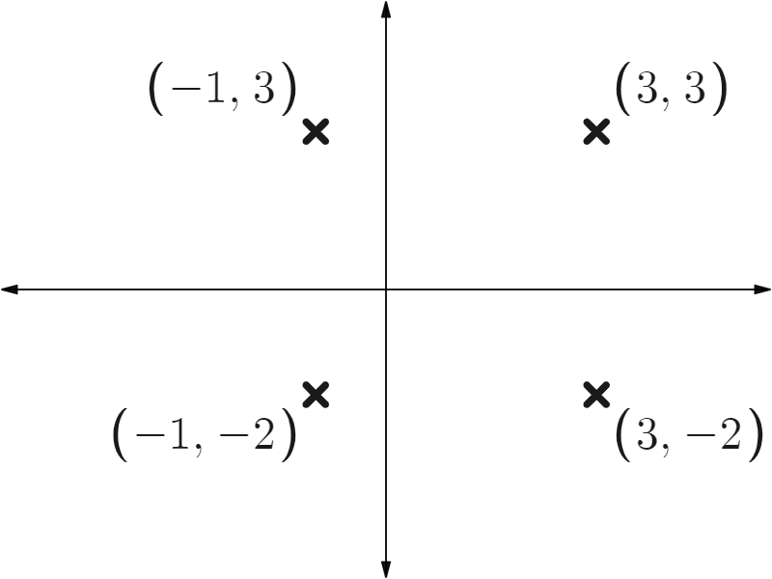
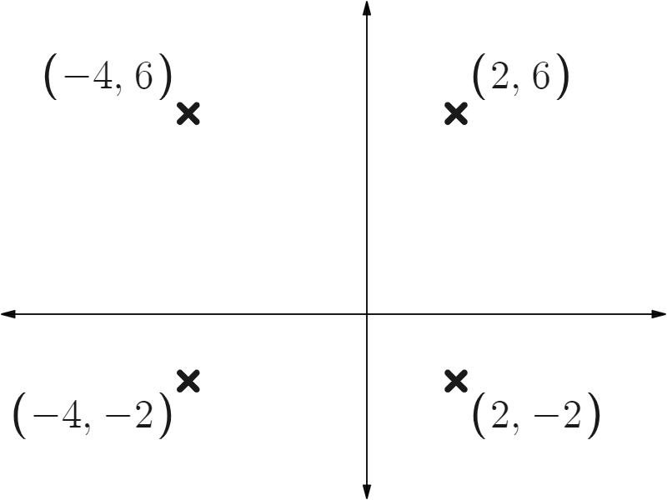
Plotting shapes in all four quadrants
2) Fill in the blank coordinates of these rectangles.
a)
b)

Slide 40
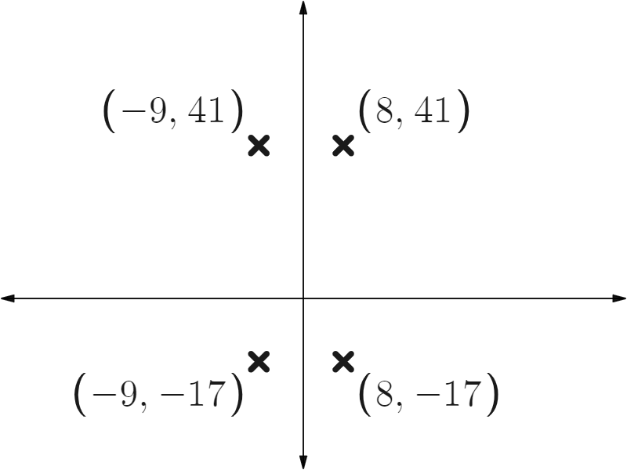
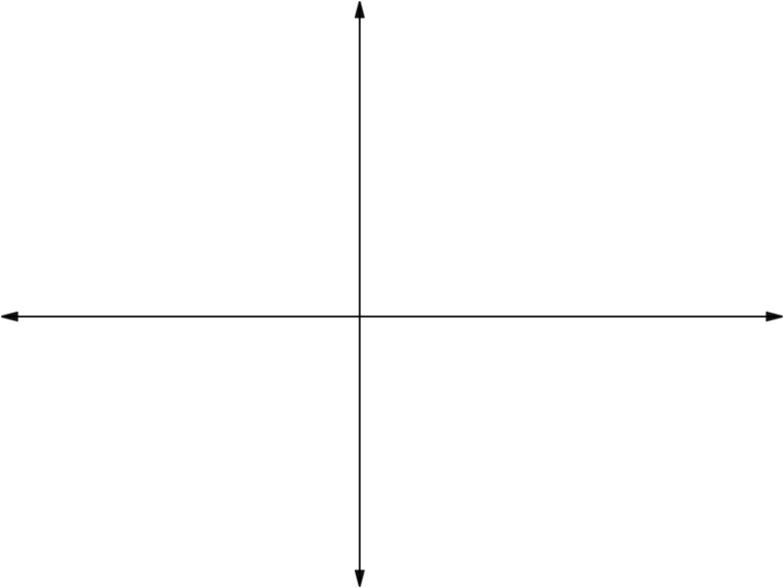
Plotting shapes in all four quadrants
2) Fill in the blank coordinates of these rectangles.
c)
d)
(c, b)
(a,b)
✖
✖
✖
✖
(c,d)
(a, d)

Slide 41
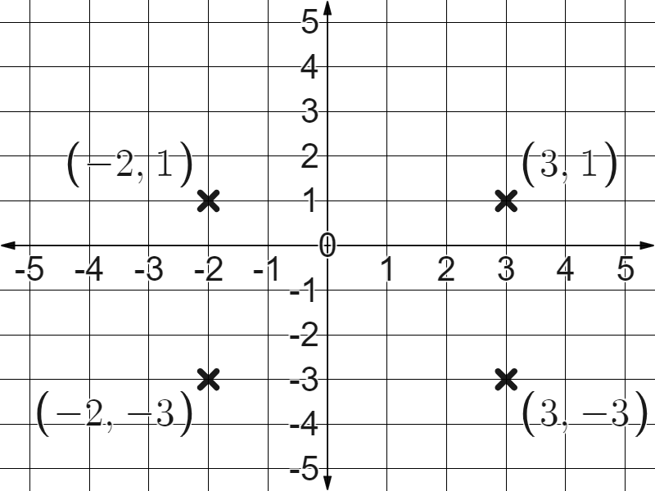
Plotting shapes in all four quadrants
1) Plot these coordinates.
What shape do they form?
(3, 1)
(-2, 1)
(-2, -3)
(3, -3)
A rectangle.

Slide 42
Plotting shapes in all four quadrants
2) Fill in the blank coordinates of these rectangles.
a)
b)

Slide 43
Plotting shapes in all four quadrants
2) Fill in the blank coordinates of these rectangles.
c)
d)
(c, b)
(a, b)
✖
✖
✖
✖
(c, d)
(a, d)

Slide 44
Securing understanding of plotting coordinates
Coordinates can be plotted in all four quadrants by considering the positive and negative directions that can be taken from the origin.
Be careful and accurate when drawing and labeling axes.
Shapes can be plotted on a coordinate grid across all four quadrants.

Slide 45

© Oak National Academy 2023.
Produced in partnership with Mathematics in Education and Industry.
Licensed on the Open Government Licence v3.0, except where otherwise stated. See Oak terms and conditions.

